Slide 1
OPTIMISATION OF ENERGY MANAGEMENT SYSTEM FOR PARELLEL MILD HYBRID VEHICLES USING RULE BASED METHOD
Seminar Electromobility SS 2019
Vishal Sharbidar Mukunda, Udai Sachdeva,Akshay Permunda
Electromobility Research Group
University of Kaiserslautern

Slide 2
INTRODUCTION
Hybrid vehicles are the need of the hour with the transition from conventional to newer cleaner powertrains.
Hybrid vehicles are vehicles that have at least two different energy converters and two different energy storage systems present on board the vehicle, utilized for vehicle propulsion.
Notes:
Advantages
1.Environmentally Friendly
2. Less Dependence on Fossil Fuels
3.Fuel efficiency increased
4.Regenerative Braking System
5.Tax incentive
Disadvantages
1.Currently more expensive than conventional
2.Less power
3.Limited battery life
4.Safety issues: High voltage in battery
5.High maintenance cost
6.Reliability: Still under study

Slide 3
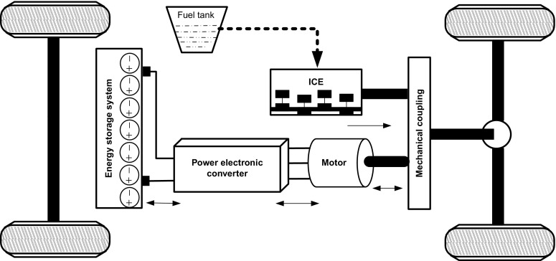
PARELLEL HYBRID
A parallel hybrid is propelled by both an internal combustion engine (ICE) and an electric motor connected to a mechanical transmission.
The ICE and motor are connected in parallel using a mechanical coupling.
https://www.sciencedirect.com/topics/engineering/parallel-hybrid-configuration

Slide 4
RULE BASED STRATERGY
Optimization of parallel mild hybrid vehicle (PHEV) by using power split energy management strategy.
The power split is done using rule based energy management strategy.
In the Rule Based Energy Management Control strategy the torque generated by the Motor is controlled while remaining torque is provided by the Engine.

Slide 5
DRIVING CYCLES
Driving cycles consists of different speed-time relations of vehicle at different driving modes.
By using these cycles fuel consumption and emissions levels are determined.
New European driving cycle (NEDC) is used to determine the emission and fuel consumption of vehicle.
EPA federal test procedure (FTP-75) is a city driving cycle, US EPA defined this cycle to measure tailpipe emissions and fuel consumption.

Slide 6
DRIVING CYCLES
 | NEDC | FTP-75
AVERAGE SPEED | 33.6 km/h | 34.1 km/h
DURATION | 1220 seconds | 1887 seconds
MAXIMUM SPEED | 120 km/h | 91.2 km/h
TOTAL DISTANCE | 11 km | 17.77 km

Slide 7
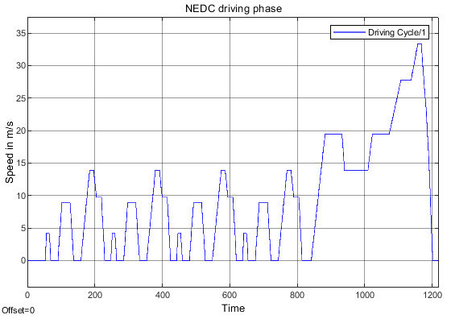
DRIVING CYCLES

Slide 8
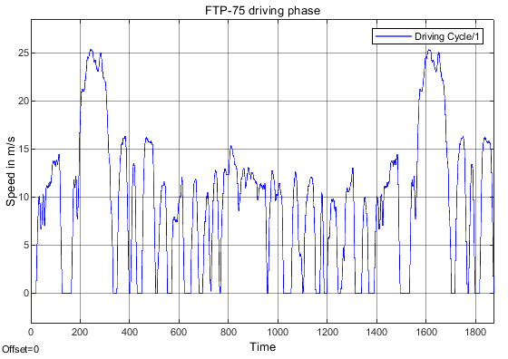
DRIVING CYCLES

Slide 9
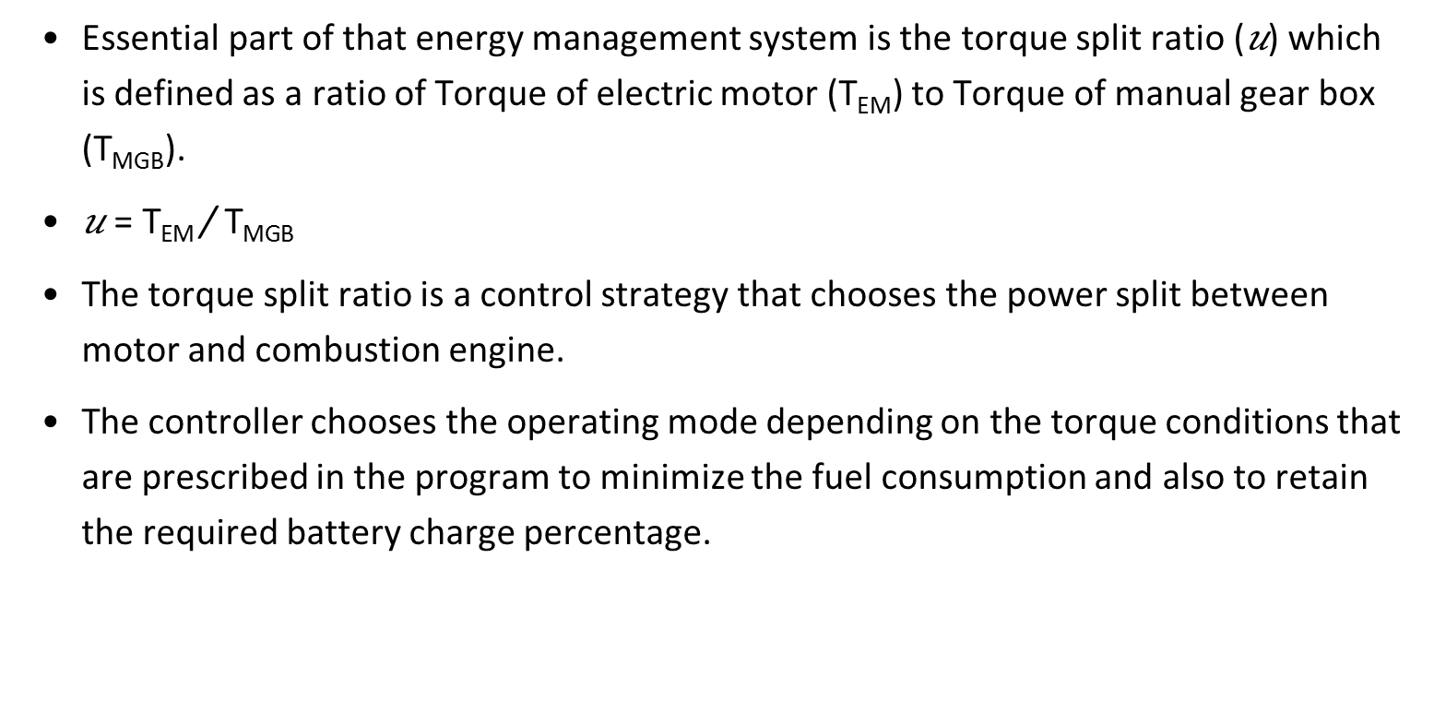
ENERGY MANAGEMENT SYSTEM
Essential part of that energy management system is the torque split ratio (𝑢) which is defined as a ratio of Torque of electric motor (T_{EM}) to Torque of manual gear box (T_{MGB}).
$\text{u} \text{=} \text{TEM} \text{/} \text{T}\text{MGB}$
The torque split ratio is a control strategy that chooses the power split between motor and combustion engine.
The controller chooses the operating mode depending on the torque conditions that are prescribed in the program to minimize the fuel consumption and also to retain the required battery charge percentage.

Slide 10

OPERATION MODES
Load point shifting :
Motor mode $\left(\text{T}\text{MGB} >0 \&0≤u<1\right)$,Generator mode$\left(\text{T}\text{MGB} >0 \&u<0\right)$ & Electric drive ($u=1)$
Regeneration: $(\text{T}\text{MGB}<0 \&u=1)$
Regeneration & friction mode $(\text{T}\text{MGB}<0 \&0≤u<1)$
Start stop
Electric drive

Slide 11
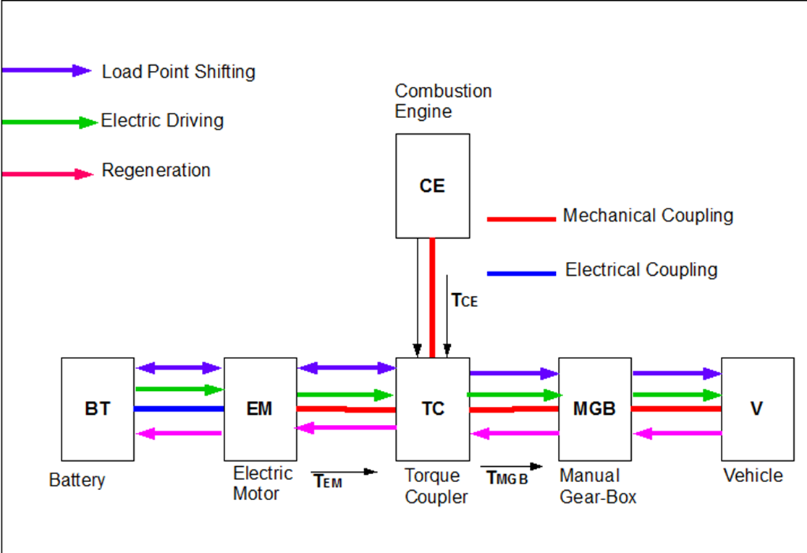
OPERATION MODES

Slide 12
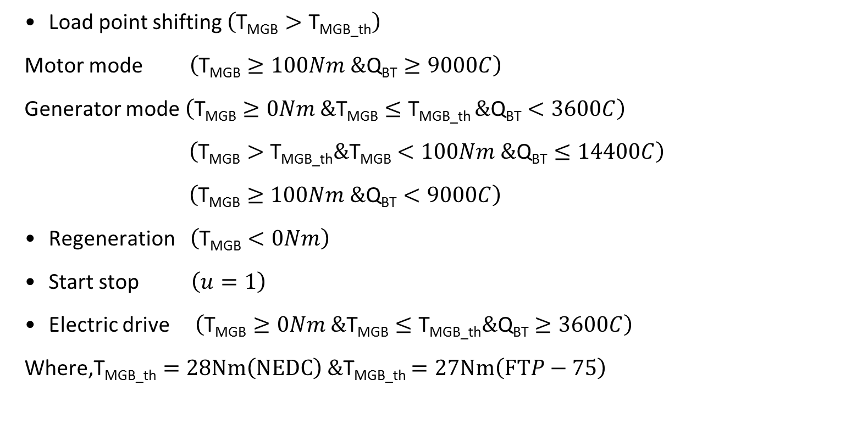
OPERATION MODES CONDITIONS
Load point shifting $\left(\text{T}\text{MGB}>\text{T}\text{MG}\text{B}\text{_}\text{th}\right)$
Motor mode $\left(\text{T}\text{MGB}≥100Nm \&\text{Q}\text{BT}≥9000C\right)$
Generator mode $\left(\text{T}\text{MGB}≥0Nm \&\text{T}\text{MGB}≤\text{T}\text{MGB}\text{_}\text{th} \&\text{Q}\text{BT}<3600C\right)$
$\left(\text{T}\text{MGB}>\text{T}\text{MGB}\text{_}\text{th}\&\text{T}\text{MGB}<100Nm \&\text{Q}\text{BT}≤14400C\right)$
$\left(\text{T}\text{MGB}≥100Nm \&\text{Q}\text{BT}<9000C\right)$
Regeneration $\left(\text{T}\text{MGB}<0Nm\right)$
Start stop $\left(u=1\right)$
Electric drive $\left(\text{T}\text{MGB}≥0Nm \&\text{T}\text{MGB}≤\text{T}\text{MGB}\text{_}\text{th}\&\text{Q}\text{BT}≥3600C\right)$
Where,$\text{T}\text{MGB}\text{_}\text{th}=28Nm\left(NEDC\right) \&\text{T}\text{MGB}\text{_}\text{th}$ $=27Nm\left(FTP−75\right)$

Slide 13
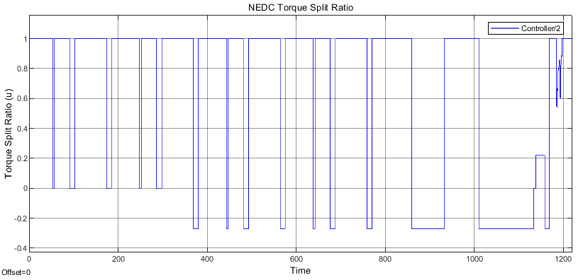
RESULTS

Slide 14
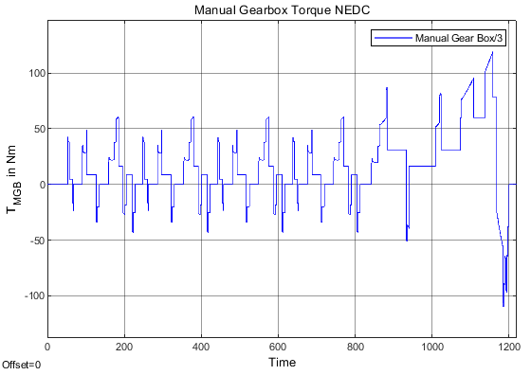
RESULTS

Slide 15
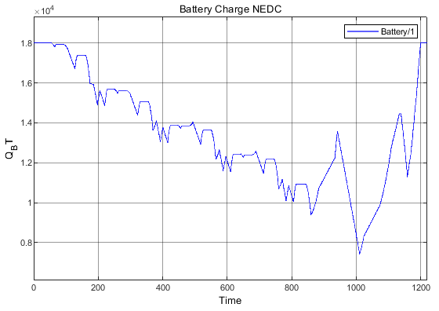
RESULTS

Slide 16
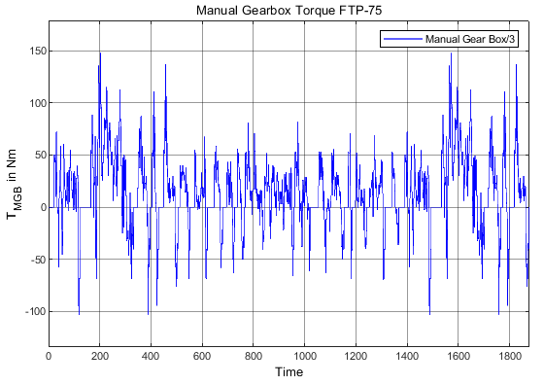
RESULTS

Slide 17
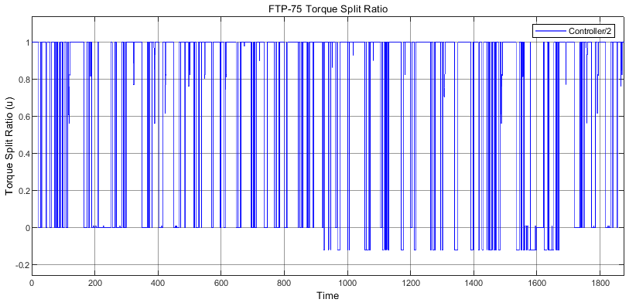
RESULTS

Slide 18
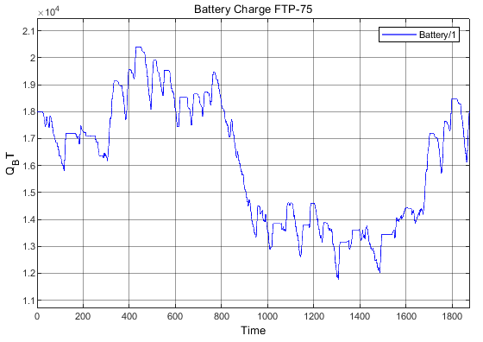
RESULTS

Slide 19
RESULTS
Fuel Consumption
Driving Cycle | CE VCE,eq [l/100kms] | HEV VCE,eq [l/100kms] | %Reduction
NEDC | 4.897 | 3.660 | 25.26
FTP-75 | 4.675 | 3.353 | 28.27
Average | 4.786 | 3.506 | 26.74

Slide 20
RESULTS
State of charge (SoC)
Driving cycles | Initial SoC ×10⁴ [C] | Final SoC ×10⁴ [C]
NEDC | 1.8 | 1.8
FTP-75 | 1.8 | 1.801

Slide 21
RESULTS
A rule based strategy was implemented
Fuel consumption for the NEDC and FTP-75 driving cycles were 3.660 liters/100km and 3.353 liters/100km respectively.
The average fuel consumption of the two driving cycles is 3.506 liters/100km
The battery charge of the vehicle is maintained at 50% for both the driving cycles.

Slide 22
THANK YOU VERY MUCH
Questions?

